Slide 1
Database Concurrency Control

Slide 2
Introduction
Multiple users.
Concurrent accesses.
Problems could arise if there is no control.
Example:
Transaction 1 (T1): withdraw $500 from account A.
Transaction 2 (T2): deposit $800 to account A.
Read(A)
A = A – 500
Write(A)
Read(A)
A = A + 800
Write(A)
T₁
T₂

Slide 3
Initially A = 1000
Sequential execution:
T1 → T2
A = 1300
T2 → T1
A = 1300
T1: read(A)
T1: A = A – 500
T2: read(A)
T2: A = A + 800
T2: write(A)
T1: write(A)
A = 500, inconsistent
T2: read(A)
T1: read(A)
T1: A = A - 500
T1: write(A)
T2: A = A + 800
T2: write(A)
A = 1800, inconsistent
Interleave execution 1
Interleave execution 2

Slide 4
Transactions
A transaction is a sequence of read/write operations.
A transaction is atomic.
Either all or none of the operations are executed.
No transaction can observe partial effect of other transactions.

Slide 5
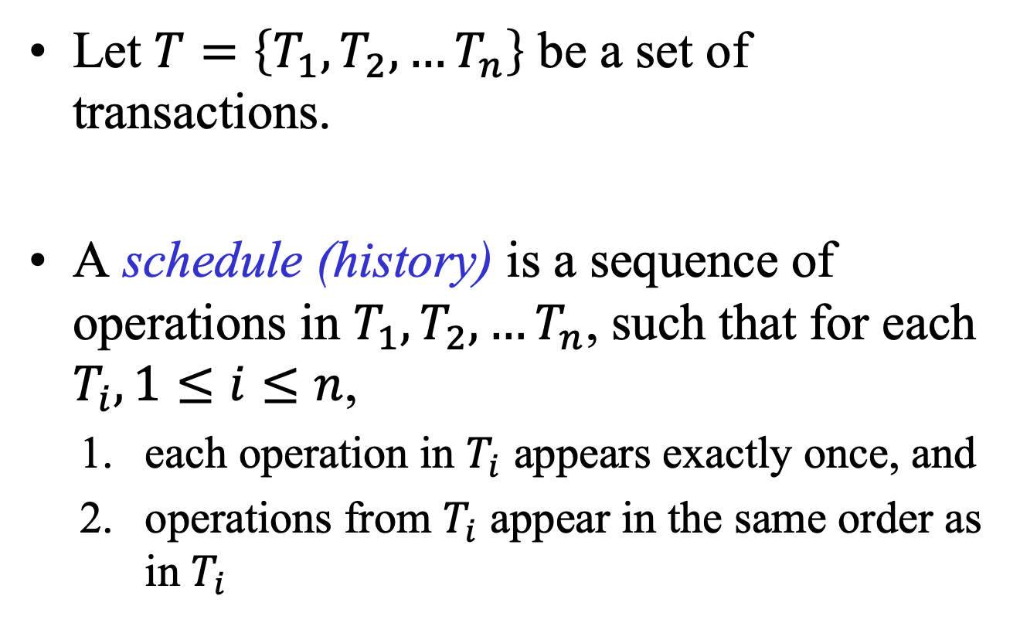
Schedule (History)
Let $T=\left\{T_{1},T_{2},…T_{n}\right\}$ be a set of transactions.
A schedule (history) is a sequence of operations in $T_{1},T_{2},…T_{n}$, such that for each $T_{i}, 1≤i≤n$,
each operation in $T_{i}$ appears exactly once, and
operations from $T_{i}$ appear in the same order as in $T_{i}$

Slide 6
Examples
T1
Read[a]
Write[b]
T2
Read[b]
Write[a]
Transaction T1
Transaction T2
T1 | T2
Read[a]
Write[b]
 | Read[b]
 | Write[a]
Read[a]
T1 | T2
Write[b]
 | Read[b]
Read[a]
 | Write[a]
Order of operations
is wrong
duplicated operations
Invalid Schedule
Invalid Schedule

Slide 7
Examples
T1 | T2
Read[a]
 | Read[b]
Write[b]
 | Write[a]
T1 | T2
Read[a]
Write[b]
 | Read[b]
 | Write[a]
Valid schedule
(interleaved schedule)
Valid schedule
(serial schedule)
r1[a] r2[b] w1[b] w2[a]
r1[a] w1[b] r2[b] w2[a]
This notation is widely used in some books
and research papers

Slide 8
A schedule (history) of T is serial if
either
all the operations in Ti appear before all the operations in Tj, or
all the operations in Tj appear before all the operations in Ti.
Assumption: Each Ti is correct when executed individually, i.e., all serial schedules are valid.
Objective: Accept schedules “equivalent” to a serial schedule (serializable schedules).
Problem: what do we mean by “equivalent”.

Slide 9
View Serializability
Equivalent: same effects
The effects of a history (schedule) are the values produced by the Write operations of unaborted transactions.
We don’t need to know anything about the computation of each transaction.
Assume that if each transaction’s Reads read the same values in two histories (schedules), then all Writes write the same values in both histories (schedules).
If for each data item x, the final Write on x is the same in both histories (schedules), then the final values of all data items will be the same in both histories (schedules).

Slide 10
Two histories (schedules) H and H' are view equivalent if
They are over the same set of transactions and have the same operations;
For any unaborted Ti, Tj and for any x, if Ti reads x from T_{j} in H then Ti reads x from Tj in H', and
For each x, if wi[x] is the final write of x in H then it is also the final write of x in H'.
Assume that there is a transaction (Tb), which initializes the values for all the data objects.
A schedule is view serializable (VSR) if it is view equivalent to a serial history (schedule).

Slide 11
Examples
r3[x]w4[x]w3[x]w6[x]
T3 read x from Tb.
The final write for x is w6[x].
View equivalent to T3 T4 T6.
r3[x] w4[x] w3[x]
T3 read x from Tb.
The final write for x is w3[x].
Not serializable.
r3[x] w4[x] r7[x] w3[x] w7[x]
T3 read x from Tb.
T7 read x from T4.
The final write for x is w7[x].
View equivalent to T3 T4 T7.
w1[x] r2[x] w2[x] r1[x]
T2 read x from T1.
T1 read x from T2
The final write for x is w2[x].
Not serializable.
Testing whether a schedule is view serializable is NP-complete

Slide 12
Conflict Serializability
Non-conflicting operations: can always be swapped without affecting the result of the other operations.
opi(A)opj(B) ↔ opj(B)opi(A) if A ≠ B
Conflicting operations:
ri[x]rj[x] ↔ rj[x]ri[x]
ri[x]wj[x]: cannot swap
wi[x]rj[x]: cannot swap
wi[x]wj[x]: cannot swap

Slide 13
Two operations are conflicting with each other if they both operate on the same data object and at least one of them is a Write.
Two histories (schedules) H and H' are conflict equivalent if
They are defined over the same set of transactions and have the same operations; and
They order conflicting operations in the same way; i.e., for any conflicting operations pi and qj belonging to transactions Ti and Tj, if pi appears before qj in H then pi appears before qj in H'.

Slide 14
Two conflict equivalent histories (schedules) can be obtained from each other by swapping consecutive non-conflicting operations.
A history (schedule) is conflict serializable (CSR) if it is conflict equivalent to a serial history (schedule).
Testing for conflict serializability can be done in polynomial time.

Slide 15
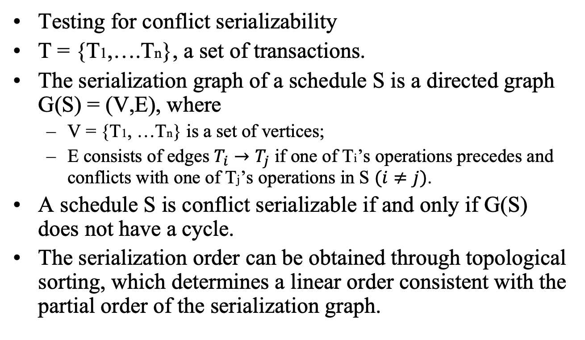
Serialization Graph
Testing for conflict serializability
T = {T1,….Tn}, a set of transactions.
The serialization graph of a schedule S is a directed graph G(S) = (V,E), where
V = {T1, …Tn} is a set of vertices;
E consists of edges $T_{i}→T_{j}$ if one of Ti’s operations precedes and conflicts with one of Tj’s operations in S $(i≠j)$.
A schedule S is conflict serializable if and only if G(S) does not have a cycle.
The serialization order can be obtained through topological sorting, which determines a linear order consistent with the partial order of the serialization graph.

Slide 16
wi[a] ri[b] rk[a] wj[b] wj[d] wk[c] rm[c] rm[d]
Ti
Tj
Tk
Serialization graph
Tm
Ti
Ti
Tj
Tk
Tk
Tj
Tm
Tm
Two possible serialization orders

Slide 17
r3[x] w4[x] w3[x] w6[x]
Not conflict serializable, as there is a cycle in the serialization graph.
But view serializable.
T3
T4
T6

Slide 18
Lock-based Protocols
Locks provide exclusive access:
Lock
Unlock
Two kinds of locks:
Shared-locks for read operations.
Exclusive-locks for write operations.
Read (shared) | Write (exclusive)
 | × | Read (share)
× | × | Write (exclusive)
Lock Table

Slide 19
Lock and unlock should be done carefully.
In the following example, locks and unlocks are not executed properly.
T1 | T2
lock-X(B) | lock-S(A)
read(B) | read(A)
B:= B - 50 | unlock(A)
write(B) | lock-S(B)
unlock(B) | read(B)
lock-X(A) | unlock(B)
read(A) | display(A+B)
A := A + 50
write(A)
unlock(A)

Slide 20
T1 | T2 | Concurrency-control manager
lock-X(B)
 |  | grant-X(B,T1)
read(B)
B := B - 50
write(B)
unlock(B)
 | lock-S(A)
 |  | grant-S(A,T2)
 | read(A)
 | unlock(A)
 | lock-S(B)
 |  | grant-S(B,T2)
 | read(B)
 | unlock(B)
 | display(A+B)
lock-X(A)
 |  | grant-X(A,T2)
read(A)
A:=A+50
write(A)
unlock(A)
A lock request will be granted, if no other transaction is holding a conflicting lock.
This execution is not serializable

Slide 21
T1 | T2
lock-X(B) read(B) B:= B - 50 write(B) lock-X(A) read(A) A := A + 50 write(A) unlock(B) unlock(A) | lock-S(A) read(A) lock-S(B) read(B) display(A+B) unlock(A) unlock(B)
The locks and unlocks are executed correctly
Strict two-phase locking protocol
- unlock all data items at the end of the transaction

Slide 22
Two-phase Locking Protocol
A transaction must obtain a lock for an operation before executing the operation.
If there exists a conflicting lock (cannot obtain the lock), then the operation has to be delayed until the conflicting lock is released.
The lock must not be released before the operation is executed.
Once a transaction releases a lock, it cannot subsequently obtain any more locks.
Each transaction issues lock and unlock requests in two phases:
Growing phase: A transaction may obtain locks but may not release any lock.
Shrinking phase: A transaction may release locks but may not obtain any new locks.

Slide 23
Locks can be upgrade in the growing phase.
Locks can be downgrade in the shrinking phase.
T1 | T2
Read(a1) Read(a2) …. Read(an) Write(a1) | Read(a1) Read(a2) Display(a1+a2)
T1 | T2
Lock-S(a1) Lock-S(a2) Lock-S(a3) Lock-S(a4) ……. …… Lock-S(an) Upgrade(a1) | Lock-S(a1) Lock-S(a2) Unlock(a1) Unlock(a2)
An incomplete schedule with a lock conversion

Slide 24
Deadlocks
Two-phase locking protocol ensures conflict serializability.
May suffer from deadlock. In this case one of the transactions involved in the deadlock has to be aborted.
T3 | T4
Lock-X(B) Read(B) B:= B – 50 Write(B)
 | Lock-S(A) Read(A) Lock-S(B)
Lock-X(A)

Slide 25
Example:
T1: r1[x] w1[y]
T2: r2[y] w2[x]
Execution: r1[x] r2[y] deadlock!
T1 waits T2 to release the read lock on y, and T2 waits T1 to release the read lock on x.
Need a strategy to detect deadlocks.

Slide 26
Timeout strategy
waiting too long for a lock.
guess that there is a deadlock.
abort the transaction.
It may abort a transaction that isn't really part of a deadlock.
No harm for wrong guess, insofar as correctness is concerned.
Performance penalty for wrong guesses.
Tune the timeout intervals.
Long enough so that most transactions that are aborted are actually deadlocked.
Short enough that deadlocked transactions don't wait too long for their deadlocks to be noticed.

Slide 27
Detect deadlocks precisely.
Maintain a Waits-for graph (WFG).
There is an edge Ti → Tj from node Ti to node Tj, iff transaction Ti is waiting for transaction Tj to release some locks.
A cycle in (WFG) implies a deadlock.
Abort one of the transactions in the cycle.

Slide 28
Wait-for graph example 1
T1 | T2 | T3
Lock-X(B) Read(B) B:=B-50 Write(B) | Lock-S(A) Read(A) Lock-S(B) | Lock-S(C) Read(C) Lock-X(A)
T1
T2
T3
There is no cycle in the wait-for
graph, therefore there is
no deadlock.

Slide 29
Wait-for graph example 2
T1 | T2 | T3
Lock-X(B) Read(B) B:=B-50 Write(B) Lock-X(A) | Lock-S(A) Read(A) Lock-S(B) | Lock-S(C) Read(C) Lock-X(B)
T1
T2
T3
There is a cycle between T1
and T2, therefore T1 and T2
are involved in the deadlock.

Slide 30
Hierarchy of Serializable Schedules
VSR
CSR
2PL
serial

